Slide 1
FAQs about software engineering
What is software?
What is software engineering?
What is the difference between software engineering and computer science?
What is the difference between software engineering and system engineering?
What is a software process?
What is a software process model?

Slide 2
FAQs about software engineering
What are the costs of software engineering?
What are software engineering methods?
What is CASE (Computer-Aided Software Engineering)
What are the attributes of good software?
What are the key challenges facing software engineering?

Slide 3
What is software?
Computer programs and associated documentation such as requirements, design models and user manuals.
Software products may be developed for a particular customer or may be developed for a general market.
Software products may be
  Generic - developed to be sold to a range of different customers e.g. PC software such as Excel or Word.
  Custom - developed for a single customer according to their specification.
New software can be created by developing new programs, configuring generic software systems or reusing existing software.

Slide 4
Nature of Software System

Slide 5
Challenges in developing software
Developing large and complex software is challenging because,
  firstly it is very effort intensive, we have to organize the work very meticulously,
  high cost is involved.
  So in case the solution is not successful the entire investment goes waste.
  It also can take long development time.

Slide 6
Challenges in developing software
  We have to take into account the changing requirements of the users.
  There is a high risk of failure.
  This risk may be in terms of variety of aspects.
  The users may not accept the solution,
  It may not meet the performance.
  The solution is such that it is not possible to maintain it up to date.

Slide 7
What is software engineering?
Software engineering is an engineering discipline that is concerned with all aspects of software production.
Software engineers should adopt a systematic and organised approach to their work and use appropriate tools and techniques depending on the problem to be solved, the development constraints and the resources available.

Slide 8
Software engineering
The economies of ALL developed nations are
dependent on software.
More and more systems are software controlled
Software engineering is concerned with theories, methods and tools for professional software development.

Slide 9
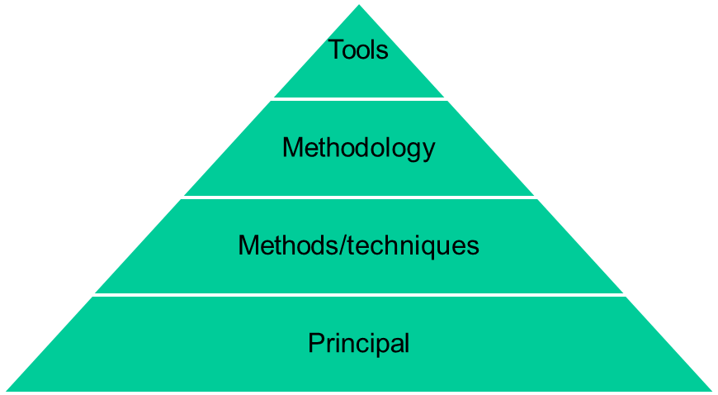
Relationship Between Principal, Methods and Techniques, Methodology and Tools

Slide 10
What is the difference between software engineering and computer science?
Computer science is concerned with theory and fundamentals; software engineering is concerned with the practicalities of developing and delivering useful software.

Slide 11
What is the difference between software engineering and system engineering?
System engineering is concerned with all aspects of computer-based systems development including hardware, software and process engineering. Software engineering is part of this process concerned with developing the software infrastructure, control, applications and databases in the system.
System engineers are involved in system specification, architectural design, integration and deployment.

Slide 12
Successful Software Projects

Slide 13
What is a software process?
A set of activities whose goal is the development or evolution of software.
Generic activities in all software processes are:
  Specification - what the system should do and its development constraints
  Development - production of the software system
  Validation - checking that the software is what the customer wants
  Evolution - changing the software in response to changing demands.

Slide 14
What is a software process model?
A simplified representation of a software process, presented from a specific perspective.
Examples of process perspectives are
  Workflow perspective - sequence of activities;
  Data-flow perspective - information flow;
  Role/action perspective - who does what.
Generic process models
  Waterfall;
  Iterative development;
  Component-based software engineering.

Slide 15
Software costs
Software costs often dominate computer system costs. The costs of software on a PC are often greater than the hardware cost.
Software costs more to maintain than it does to develop. For systems with a long life, maintenance costs may be several times development costs.
Software engineering is concerned with cost-effective software development.

Slide 16
What are the costs of software engineering?
Roughly 60% of costs are development costs, 40% are testing costs. For custom software, evolution costs often exceed development costs.
Costs vary depending on the type of system being developed and the requirements of system attributes such as performance and system reliability.
Distribution of costs depends on the development model that is used.

Slide 17
What are software engineering methods?
Structured approaches to software development which include system models, notations, rules, design advice and process guidance.
Model descriptions
  Descriptions of graphical models which should be produced;
Rules
  Constraints applied to system models;
Recommendations
  Advice on good design practice;
Process guidance
  What activities to follow.

Slide 18
What is CASE (Computer-Aided Software Engineering)
Software systems that are intended to provide automated support for software process activities.
Upper-CASE
  Tools to support the early process activities of requirements and design;
Lower-CASE
  Tools to support later activities such as programming, debugging and testing.

Slide 19
What are the attributes of good software?
The software should deliver the required functionality and performance to the user and should be maintainable, dependable and acceptable.
Maintainability
  Software must evolve to meet changing needs;
Dependability
  Software must be trustworthy;
Efficiency
  Software should not make wasteful use of system resources;
Acceptability
  Software must accepted by the users for which it was designed. This means it must be understandable, usable and compatible with other systems.

Slide 20
What are the key challenges facing software engineering?
Heterogeneity, delivery and trust.
Heterogeneity
  Developing techniques for building software that can cope with heterogeneous platforms and execution environments;
Delivery
  Developing techniques that lead to faster delivery of software;
Trust
  Developing techniques that demonstrate that software can be trusted by its users.

Slide 21
Phases of Software Engineering
System identification
System modelling
System integration
System installation
System growth
System decommissioning

Slide 22
What is a system?
A purposeful collection of inter-related components working together to achieve some common objective.
A system may include software, mechanical, electrical and electronic hardware and be operated by people.
System components are dependent on other
system components
The properties and behaviour of system components are inextricably inter-mingled

Slide 23
System categories
Technical computer-based systems
  Systems that include hardware and software but where the operators and operational processes are not normally considered to be part of the system. The system is not self-aware.
Socio-technical systems
  Systems that include technical systems but also operational processes and people who use and interact with the technical system. Socio-technical systems are governed by organisational policies and rules.

Slide 24
Systems engineering
Specifying, designing, implementing, validating, deploying and maintaining socio-technical systems.
Concerned with the services provided by the system, constraints on its construction and operation and the ways in which it is used.

Slide 25
System modelling
An architectural model presents an abstract view of the sub-systems making up a system
May include major information flows between sub-systems
Usually presented as a block diagram
May identify different types of functional component in the model

Slide 26
System integration
The process of putting hardware, software and
people together to make a system.
Should be tackled incrementally so that sub-systems are integrated one at a time.
Interface problems between sub-systems are usually found at this stage.
May be problems with uncoordinated deliveries
of system components.

Slide 27
System installation
After completion, the system has to be installed in the customer’s environment
  Environmental assumptions may be incorrect;
  May be human resistance to the introduction of
  a new system;
  System may have to coexist with alternative
  systems for some time;
  May be physical installation problems (e.g.
  cabling problems);
  Operator training has to be identified.

Slide 28
System growth
Large systems have a long lifetime. They must evolve to meet changing requirements.
Evolution is inherently costly
  Changes must be analysed from a technical and business perspective;
  Sub-systems interact so unanticipated problems can arise;
  There is rarely a rationale for original design decisions;
  System structure is corrupted as changes are made to it.

Slide 29
System decommissioning
Taking the system out of service after its useful lifetime.
May require removal of materials (e.g. dangerous chemicals) which pollute the environment
  Should be planned for in the system design by encapsulation.
May require data to be restructured and converted to be used in some other system.

Slide 30
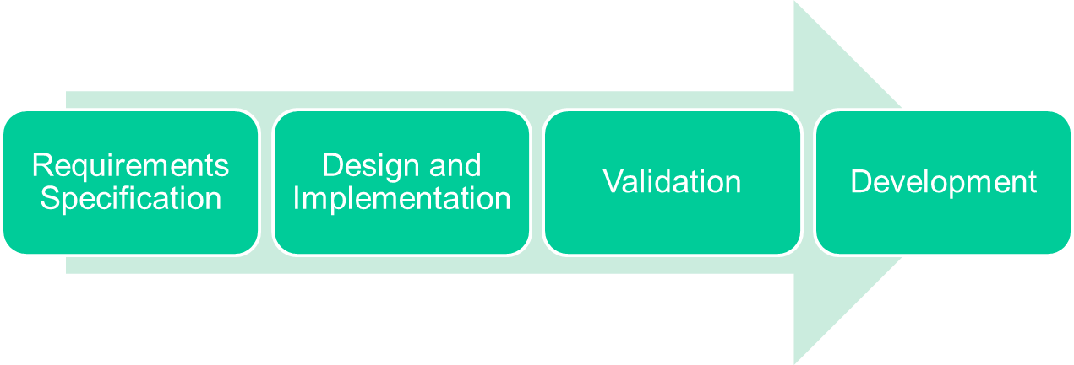
A Software Process is
A structured set of activities required to develop a software system

Slide 31
Ad hoc Software Development
Developing software without planning for each phase, and without specifying tasks, deliverables, or time constraints.
Relies entirely on the skills and experience of the individual staff for performing the work.
The software process is constantly changed or modified as the work progresses.

Slide 32
Software Process Model
A Software process Model which is
“an abstract representation of a process. It presents a description of a process from some particular perspective.”
It provides guidelines to organize how software process activities should be performed and in what order.

Slide 33
SDLC
and
Software Process Models

Slide 34
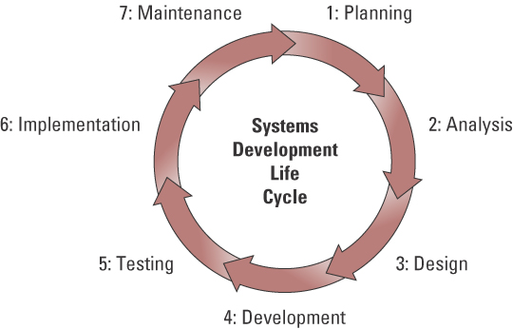
Systems Development Life Cycle (SDLC)
SDLC - the overall process for developing ISs from planning and analysis through implementation and maintenance

Slide 35
SDLC: Planning
Planning phase – involves establishing a high-level plan of the intended project and determining project goals.
When creating a feasibility study, it is important to focus on
  Economic feasibility- assesses the costs and benefits of the new system – “Is building the new system cost effective?”
  Operational feasibility evaluates whether people in the organization will use the new system – “Will the new system be used by the people in the organization?”
  Technical feasibility examines the technical aspects of the new system – “Is it technically possible to create the new system?”

Slide 36
SDLC: Analysis Phase
Analysis phase – involves analyzing end-user business requirements and refining project goals into defined functions and operations of the intended system
Business requirements – the detailed set of business requests that the system must meet in order to be successful
Three steps:
  understanding the old system
  identifying how the old system can be improved
  developing specifications for the new system

Slide 37
SDLC: Design Phase
Design phase – involves describing the desired features and operations of the system including screen layouts, business rules, process diagrams, pseudo code, and other documentation
The design phase addresses "how" the system will accomplish the objectives
During the design phase, each portion of the new system is designed in detail, including the user interface, data structure, and the program design

Slide 38
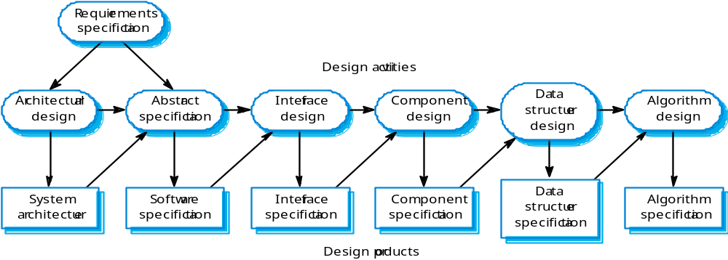
The software design process

Slide 39
Design process activities
Architectural design
Interface design
  Input Design
  Output Design
Component design
Data structure design
Algorithm design

Slide 40
Structured methods
Systematic approaches to developing a software design.
The design is usually documented as a set of graphical models.
Possible models
  Object model;
  Sequence model;
  State transition model;
  Structural model;
  Data-flow model.

Slide 41
SDLC: Development & Testing Phases
Development phase – involves taking all of the detailed design documents from the design phase and transforming them into the actual system
Testing phase – involves bringing all the project pieces together into a special testing environment to test for errors, bugs, and interoperability and verify that the system meets all of the business requirements defined in the analysis phase

Slide 42
Testing stages
Component or unit testing
  Individual components are tested independently;
  Components may be functions or objects or coherent groupings of these entities.
System testing
  Testing of the system as a whole. Testing of emergent properties is particularly important.
Acceptance testing
  Testing with customer data to check that the system meets the customer’s needs.

Slide 43
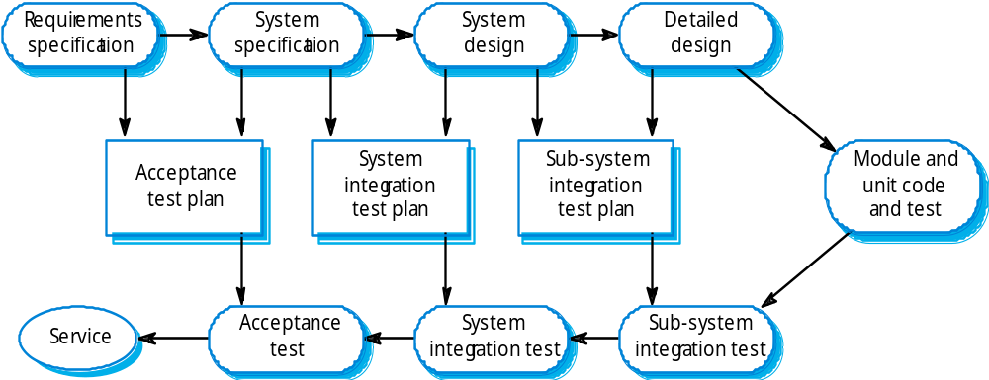
Testing phases

Slide 44
SDLC: Implementation Phase
Implementation phase – involves placing the system into production so users can begin to perform actual business operations with the system

Slide 45
SDLC: Maintenance phase
Maintenance phase – involves performing changes, corrections, additions, and upgrades to ensure the system continues to meet the business goals

Slide 46
Generic software process models
The waterfall model
  Separate and distinct phases of specification and development.
Evolutionary development
  Specification, development and validation are interleaved.
Component-based software engineering
  The system is assembled from existing components.
Iterative Model

Slide 47
The Waterfall Model
Oldest model, it’s been around since 1970.
Called “Linear Sequential Model”.
Most widely used model for SW engineering
Documentation is produced at each stage.

Slide 48
Phases
Requirements analysis and definition
System and software design
Implementation and unit testing
Integration and system testing
Operation and maintenance

Slide 49
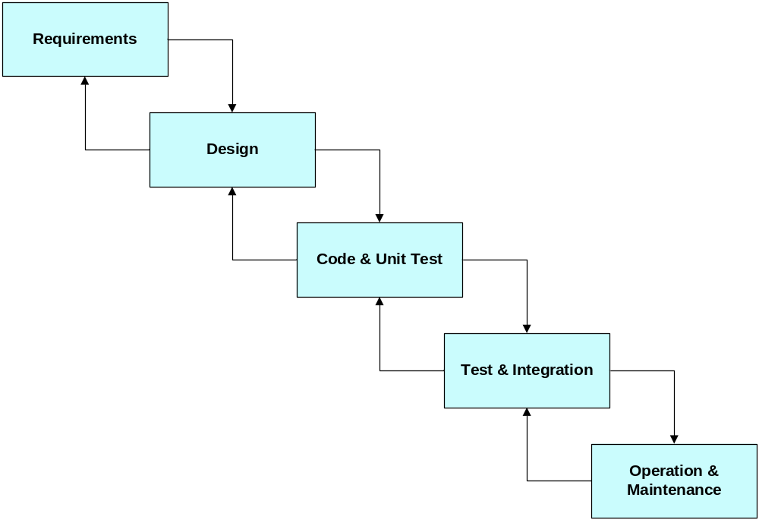
Waterfall model diagram

Slide 50
Disadvantages
The main drawback of the waterfall model is the difficulty of accommodating change after the process is underway.
One phase has to be complete before moving onto the next phase.
Inflexible partitioning of the project into distinct stages makes it difficult to respond to changing customer requirements.
Only appropriate when the requirements are well-understood and changes will be fairly limited during the design process.

Slide 51
The Prototyping Model
When a customer defines a set of general objectives for a software but does not identify detailed input, processing, or output requirement.
It consists of the iterating phases:
  Requirements gathering
  Design and build SW prototype
  Evaluate prototype with customer
  Refine requirements

Slide 52
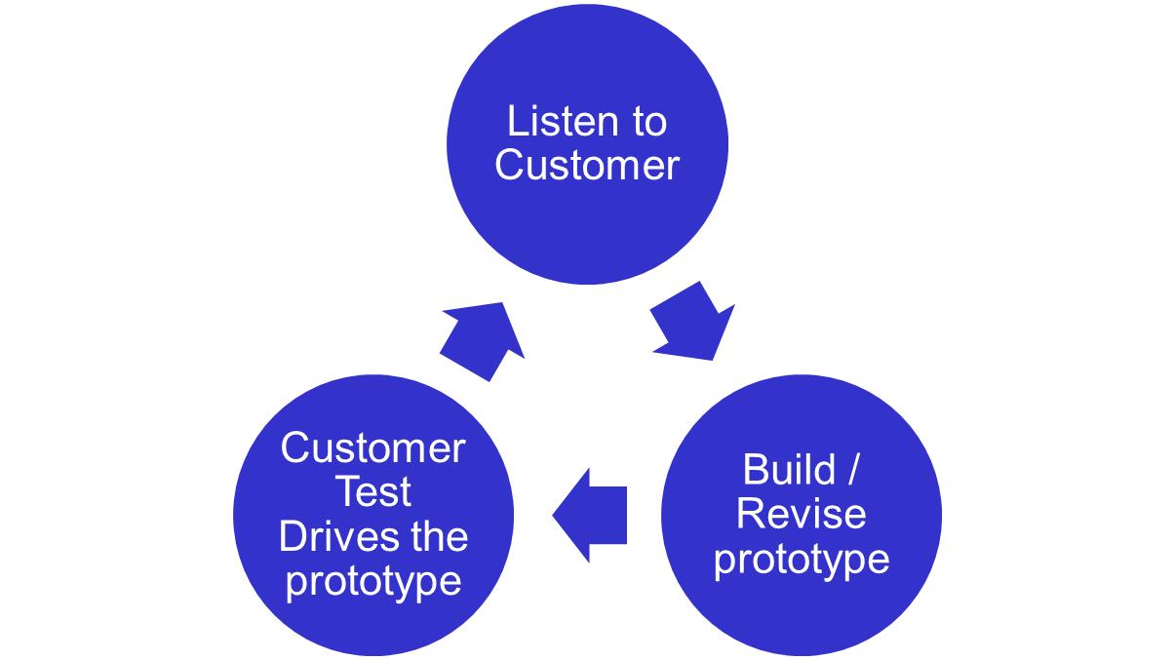
The Prototyping Model

Slide 53
The Prototyping Model
Advantages
  Users get a feel for the actual system
  Developers get to build something immediately
  Specifications can be developed incrementally
Disadvantages
  The developer may make implementation compromises in order to get a prototype working quickly.
  The process in not visible (few documents that reflect every version of the system)
  Systems poorly structured

Slide 54
THE RAPID APPLICATION DEVELOPMENT (RAD) MODEL
Rapid application development (RAD) is an incremental software development process model that emphasizes an extremely short development cycle.
The RAD model is a “high-speed” adaptation of the linear sequential model in which rapid development is achieved by using component-based construction.
If requirements are well understood and project scope is constrained, the RAD process enables a development team to create a “fully functional system” within very short time periods (e.g., 60 to 90 days).

Slide 55
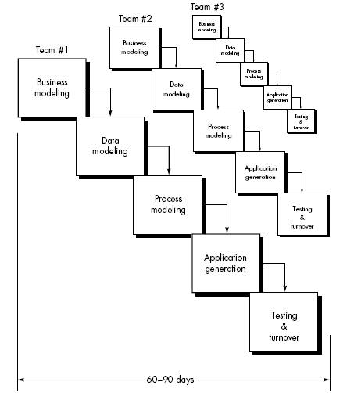
THE RAD MODEL
Phases of RAD Model

Slide 56
THE RAD MODEL
Business modeling Phase
Data Modeling phase
Process modeling phase
Application generation phase
Testing and turnover phase

Slide 57
Phases of RAD Model
Business modeling Phase: The information flow among business functions is modeled in a way that answers the following questions:
  What information drives the business process?
  What information is generated? Who generates it? Where does the information go?
  Who processes it?

Slide 58
Phases of RAD Model
Data Modeling phase : The information flow defined as part of the business modeling phase is refined into a set of data objects that are needed to support the business.
The characteristics (called attributes) of each object are identified and the relationships between these objects defined.

Slide 59
Phases of RAD Model
Process modeling phase: The data objects defined in the data modeling phase are transformed to achieve the information flow necessary to implement a business function.
Processing descriptions are created for adding, modifying, deleting, or retrieving a data object.

Slide 60
Phases of RAD Model
Application generation phase: RAD assumes the use of fourth generation techniques rather than creating software using conventional third generation programming languages.
The RAD process works to reuse existing program components (when possible) or create reusable components (when necessary).
In all cases, automated tools are used to facilitate construction of the software.

Slide 61
Phases of RAD Model
Testing and turnover phase: Since the RAD process emphasizes reuse, many of the program components have already been tested.
This reduces overall testing time.
However, new components must be tested and all interfaces must be fully exercised.

Slide 62
Drawbacks of RAD
The RAD approach has few drawbacks :
For large but scalable projects, RAD requires sufficient human resources to create the right number of RAD teams.
If commitment is lacking, RAD projects will fail.

Slide 63
Drawbacks of RAD
Not all types of applications are appropriate for RAD. If a system cannot be properly modularized, building the components necessary for RAD will be problematic.
If high performance is an issue and performance is to be achieved through tuning the interfaces to system components, the RAD approach may not work.
RAD is not appropriate when technical risks are high.

Slide 64
Evolutionary Models
Software, like all complex systems, changes over a period of time.
Business and product requirements often change as development proceeds so making a straight path to an end product unrealistic.
In these and similar situations, software engineers need a process model that has been explicitly designed to accommodate a product that evolves over time.

Slide 65
Evolutionary Models
Evolutionary models are iterative.
They are characterized in a manner that enables software engineers to develop increasingly more complete versions of the software.
  The Incremental Model
  The Spiral Model

Slide 66
The Incremental Model
Rather than deliver the system as a single delivery, the development and delivery is broken down into increments with each increment delivering part of the required functionality.
User requirements are prioritised and the highest priority requirements are included in early increments.
Once the development of an increment is started, the requirements are frozen though requirements for later increments can continue to evolve.

Slide 67
The Incremental Model
For example, word-processing software developed using the incremental paradigm might deliver basic file management, editing, and document production functions in the ﬁrst increment;
More sophisticated editing and document production capabilities in the second increment;
Spelling and grammar checking in the third increment;
Advanced page layout capability in the fourth increment.

Slide 68
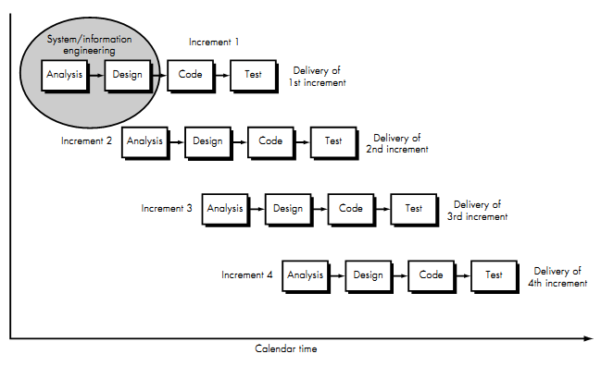
The Incremental Model

Slide 69
The Incremental Model
When an incremental model is used, the first increment is often a core product.
That is, basic requirements are addressed, but many supplementary features (some known, others unknown) remain undelivered.
The core product is used by the customer (or undergoes detailed review).
As a result of use and/or evaluation, a plan is developed for the next increment.
This process is repeated following the delivery of each increment, until the complete product is produced.

Slide 70
The Incremental Model
Advantages:
Customer value can be delivered with each increment so system functionality is available earlier.
Early increments act as a prototype to help extract requirements for later increments.
Lower risk of overall project failure.

Slide 71
The Incremental Model
Disadvantages:
Increments should be relatively small (20,000 lines of code)
Can be difficult to map the customer’s requirements onto increments of the right size.
Hard to identify common functions

Slide 72
The Spiral Model
The spiral model, is an evolutionary software process model that couples the iterative nature of prototyping with the controlled and systematic aspects of the linear sequential model.
Process is represented as a spiral rather than as a sequence of activities with backtracking.
Each loop in the spiral represents a phase in the process.
Suitable for large, expensive and complicated projects

Slide 73
The Spiral Model
Using the spiral model, software is developed in a series of incremental releases.
During early iterations, the incremental release might be a paper model or prototype.
During later iterations, increasingly more complete versions of the engineered system are produced.

Slide 74
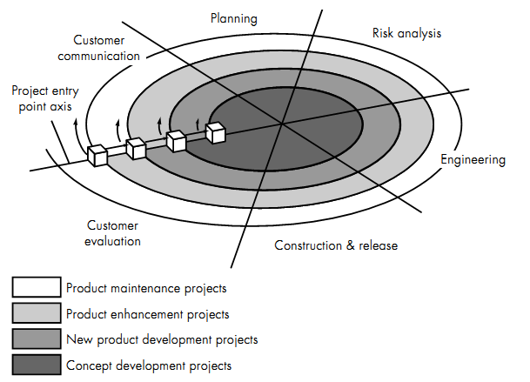
The Spiral Model

Slide 75
The Spiral Model
Objective setting
  Specific objectives for the phase are identified.
Risk assessment and reduction
  Risks are assessed and activities put in place to reduce the key risks.
Development and validation
  A development model for the system is chosen which can be any of the generic models.
Planning
  The project is reviewed and the next phase of the spiral is planned.

Slide 76
The Spiral Model
Risk driven process model
  Different risk patterns can lead to choosing different process models
What is a risk?
  Situations or possible events that may cause a project to fail to meet its goal.
  Example risks:
    Experienced staff leave the project
    Hardware which is essential for the system will not be delivered on schedule

Slide 77
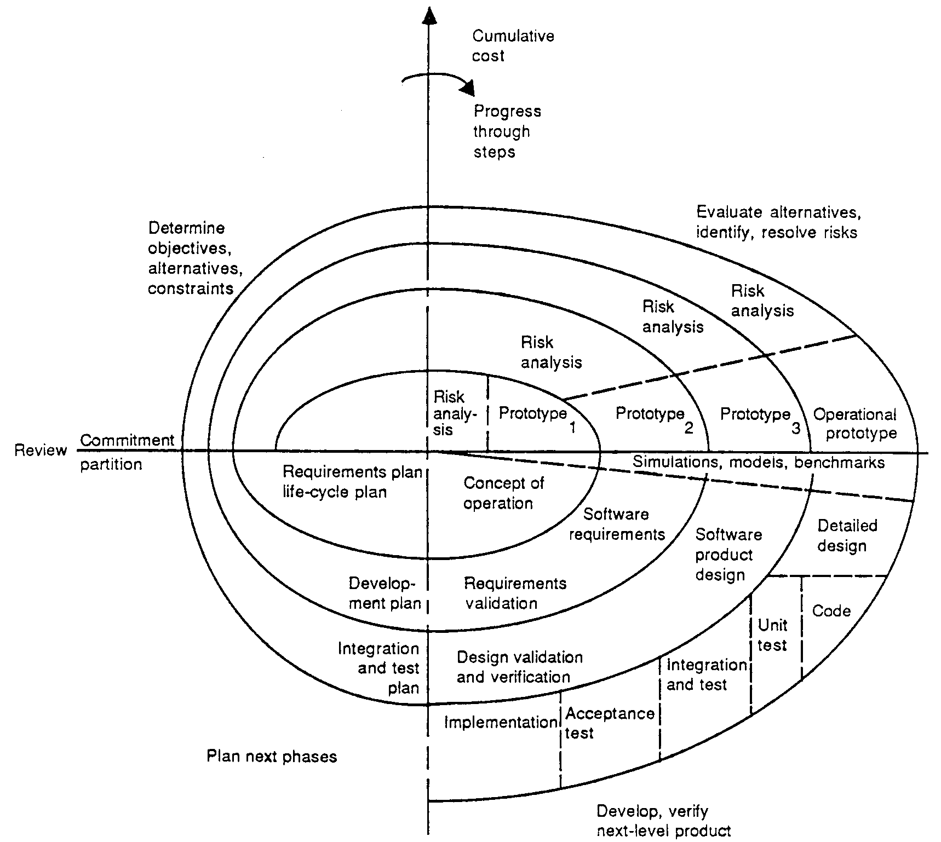
Example Spiral model project

Slide 78
The Spiral Model
Advantages:
Risks are explicitly assessed and resolved throughout the process.
Software engineers can start working on the project earlier rather than going through a lengthy early design process.

Slide 79
The Spiral Model
Disadvantages:
Requires highly skilled people in risk analysis and planning
Requires more time, and is more expensive
Estimates of budget and time are harder to judge at the beginning of the project since the requirements evolve through the process

Slide 80
Component Based Software Engineering (CBSE)
Based on systematic reuse where systems are integrated from existing components.
Process stages
  Component analysis;
  Requirements modification;
  System design with reuse;
  Development and integration.
This approach is becoming increasingly used as component standards have emerged.

Slide 81
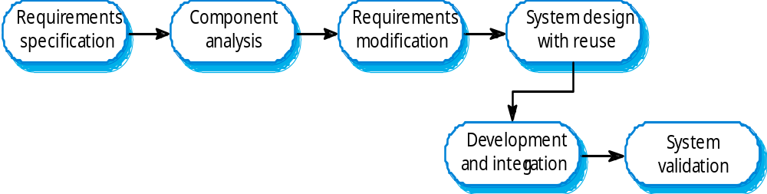
Component Based Software Engineering (CBSE)

Slide 82
Component Based Software Engineering (CBSE)
Advantages:
  Reduce amount of software to be developed
  Reduce costs and risks
  Faster delivery
Disadvantages:
  Requirements compromises, system does not meet real needs of users
  Limited features

Slide 83
AGILE & EXTREME PROGRAMMING

Slide 84
Covered Topics
What is Agile Programming
What is Extreme Programming (XP)
Why would I use Extreme Programming?
Values of XP
Principals of XP
Activities of XP
Dangers of XP

Slide 85
What is “Agility”?
Effective (rapid and adaptive) response to change
Effective communication among all stakeholders
Drawing the customer onto the team
Yielding …
Rapid, incremental delivery of software
SWE 418 (062)
Agile Software Processes-XP

Slide 86
Agile properties
Other Models
Predictive
Process-Oriented
Agile
Adaptive
People-Oriented
Notes:
Agile methods are adaptive rather than predictive. Engineering methods tend to try to plan out a large part of the software process in great detail for a long span of time, this works well until things change. So their nature is to resist change. The agile methods, however, welcome change. They try to be processes that adapt and thrive on change, even to the point of changing themselves.
Agile methods are people-oriented rather than process-oriented. The goal of engineering methods is to define a process that will work well whoever happens to be using it. Agile methods assert that no process will ever make up the the skill of the development team, so the role of a process is to support the development team in their work.

Slide 87
An Agile process
Is driven by customer descriptions of what is required (Scenarios)(User Stories)
Recognizes that plans are short-lived
Develops software iteratively with a heavy emphasis on construction activities
Delivers multiple ‘software increments’
Adapts as changes occur
SWE 418 (062)

Slide 88
Manifesto for
Agile Software Development
We are uncovering better ways of developing software by doing it and helping others to do it. Through this work we have come to value:
Individuals and interactions over processes and tools;
Working software over comprehensive documentation;
Customer collaboration over contract negotiation;
Responding to change over following a plan.
Notes:
The XP Gang: Scrum: Adaptive:
Kent Beck Mike Beedle Jim Highsmith
Ward Cunningham Ken Schwaber
Martin Fowler Jeff Sutherland
James Grenning
Ron Jeffries
Robert C. Martin
FDD: DSDM: Crystal and MPP:
Jon Kern Arie van Bennekum Alistair Cockburn
Schlaer/Mellor: Independents:
Steve Mellor Andrew Hunt
Brian Marick
Dave Thomas

Slide 89
Definition
What Is Extreme Programming?
“Extreme Programming (XP) is one of a growing group of agile software development methodologies. XP uses integrated teams of programmers, customers, and managers to develop high-quality software at high speed”.
XP Team
Programmers
Customers
Managers

Slide 90
Definition
Extreme Programming differs from traditional methodologies primarily in placing a higher value on adaptability than on predictability.
In XP “Working software is the primary measure of progress.”

Slide 91
Other Agile Processes
The Crystal Methodology Family: crystalmethodologies.org
Scrum:
www.controlchaos.com
Adaptive Software Development: www.adaptivesd.com
DSDM (Dynamic System Development Method):
www.dsdm.org

Slide 92
XP is Different
Early, concrete, and continuous feedback from short-cycles.
Incremental planning approach.
Flexibility of scheduling the implementation based on changing business needs.
Reliance on tests written by the programmers.
Reliance on the collaboration of programmers.
SWE 418 (062)
Agile Software Processes-XP

Slide 93
The Core XP Practices
Rapid, fine feedback:
  Test-driven design (via unit and acceptance tests)
  On-site customer
  Pair programming
Shared Understanding:
  Simple Design
  Collective Code Ownership
  Coding Conventions
Continuous process:
  Continuous integration
  Merciless refactoring
  Small, frequent releases
Developer Welfare:
  Forty-hour week

Slide 94
Software Processes
Waterfall
Iterative
XP
Analysis
Design
Code
Test
Kent Beck 1999
SWE 418 (062)
Agile Software Processes-XP

Slide 95
“Circles of Life”
On-site Customer
Coding
Standards
Metaphor
Refactoring
Customer – Team – Developer Pair – Team – Customer
Acceptance
Tests
Unit Tests
Pair
Programming
Release
Planning
Continuous
Integration
Collective
Ownership
Simple Design
Sustainable
Pace
Small Releases
Notes:
Different Roles within the Extreme Programming methodology work with some of the practices more than others. This “Circle of Life” diagram (adapted from Ron Jefferies papers on XP) shows how the customer is more involved with the “outer ring” practices, the team is involved in all practices, and developers, or pairs of developers are involved in some of the “inner ring” practices.

Slide 96
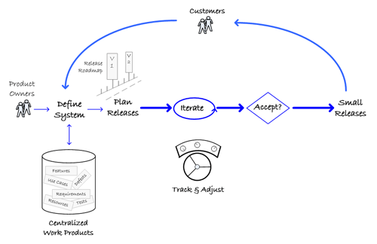
Steps of XP

Slide 97
Cost of Errors Increases Through a Project’s Lifetime
Cost of Errors
Project Phase

Slide 98
The Software Engineering Solution
Try to push changes as far toward the start of the process as possible:
Cost of Errors
Project Phase

Slide 99
The XP Answer
Find ways to make change cheaper
Find inexpensive ways of avoiding errors
Reduce overall cost of development

Slide 100
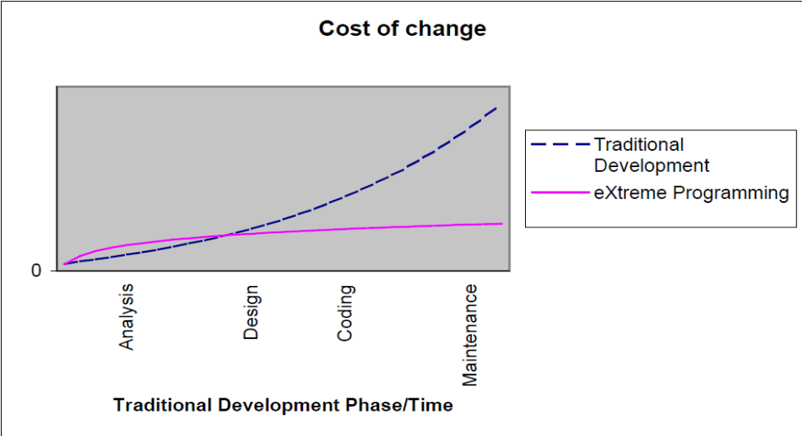
Traditional Development exponential curve vs. Extreme Programming Curve
XP keeps the cost of change low, so that it's
not much more expensive to implement a feature later than it is to implement it now, and then leverages this cost-of-change environment to produce software faster.

Slide 101
Thinking of Extreme Programming
The main aim of XP is to reduce the cost of change.
In traditional system development methods the requirements for the system are determined at the beginning of the development project and often fixed from that point on.
This means that the cost of changing the requirements at a later stage (a common feature of software engineering projects) will be high.

Slide 102
Why would I use Extreme Programming?
Most software projects use an ad-hoc approach to development known as “code and fix".
Several studies have found that 40% to 80% of a typical software project's budget goes into fixing defects that were created earlier on the same project.
So to lower this curve of change XP is used.

Slide 103
Why would I use Extreme Programming?
“Requirements-Analysis-Design-Code-Test-maintain” as a assembly line.
➔ Assumption that the shape of the finished product is known before the process begins.
But, if a customer specify something completely new and needs constant feedback to validate their choices. Then XP comes into scene.

Slide 104
Values of Extreme Programming
The Five Values:
Communication.--The most efficient and effective method of achieving shared understanding is face-to-face communication.
Simplicity.-- Looking for the simplest working solution first and improving it later only when the need arises
Feedback.-- XP teams get frequent feedback.
Courage.-- If people are scared to fail then they'll go too slowly.

Slide 105
Values of Extreme Programming
Respect.-- In Extreme Programming, team members respect each other because:
Programmers never commit changes that break compilation, that make existing unit-tests fail, or that otherwise delay the work of their peers.
Team Members always determined for high quality and seeking for the best design for the solution at hand through refactoring.

Slide 106
Principles of Extreme Programming
Feedback is most useful if it is done rapidly. In Extreme Programming, unlike traditional system development methods, contact with the customer occurs in small iterations.
Assuming simplicity is about treating every problem as if its solution were "extremely simple"

Slide 107
Principles of Extreme Programming
The principle of embracing change is about not working against changes but accepting them.
The advocates of Extreme Programming say that making big changes all at once does not work.
Extreme Programming applies incremental changes.
By making many little steps the customer has more control over the development process and the system that is being developed.

Slide 108
Activities of Extreme Programming
Coding : The only truly important product of the system development process is code (a concept to which they give a somewhat broader definition than might be given by others). Without code you have nothing.
Testing: One cannot be certain of anything unless one has tested it.
XP Milestones
Listening
Designing
Coding
Testing

Slide 109
Activities of Extreme Programming
Listening : For the programmers to find what the functionality of the system should be, they have to listen to business.
Designing :One can come a long way without designing but at a given time one will get stuck. The system becomes too complex and there may be dependencies within the system.

Slide 110
Twelve practices of XP
1. Pair programming
2. Refactoring
3. Simple design
4. Collective code ownership
5. Continuous integration
6. On-site customer
7. Small releases
8. 40-hour week
9. Coding standard
10. System metaphor (Imagine)
11. The planning game
12. Testing

Slide 111
1. Pair programming
In XP, pairs of developers write all production code. This approach may sound inefficient.
Pair programming provides many benefits:
All design decisions involve at least two brains.
At least two people are familiar with every part of the system.
There is less chance of both people neglecting tests.
Changing pairs spreads knowledge throughout the team.
Code is always being reviewed by at least one more person.
Research also is showing that programming in pairs is actually more efficient than programming alone.

Slide 112

Pair Programming
All production code written with 2 programmers at 1 machine
  One tactical, one strategic
Pairing should be dynamic
  Members in pair switch roles every 30-60 minutes
  Change pairs each task
Experiments showing effectivenes

Slide 113
2. Refactoring
Refactoring is the technique of improving code without changing functionality.
Developers try to make easier, if changing existing code would make implementing the new feature.
Refactoring lets you incorporate that learning into your code without breaking the tests. That means it will survive longer.

Slide 114
3. Simple design
XP says design should not be done all at once. We always try to use the simplest design that could possibly work at any point, changing it as we go to reflect emerging reality.
What is the simplest design that could possibly work?
Runs all the tests
Contains no duplicate code
States the programmers' intent for all code clearly
Contains the fewest possible classes and methods
Don't include extra features that aren't being used. We call such things YAGNI, which stands for "You Aren't Going to Need It."

Slide 115
4. Collective code ownership
Any person on the team should have the authority to make changes to the code to improve it.
Everybody owns all the code, meaning everybody is responsible for it.
Saying that everybody owns all the code isn't the same as saying that nobody owns it.
XP says, "You break it, you fix it." We have unit tests that must run before and after each integration. If you break something, it's your responsibility to fix it.

Slide 116
5. Continuous integration
Frequent code integration helps you to avoid integration nightmares.
XP teams integrate their code several times a day, after they get all the unit tests for the system to run.
Traditional approaches tend to work like this: code a lot, do integration, then spend a significant amount of time fixing the problems.
When you integrate frequently, the cause of failure for any particular integration is more obvious.
Fixing is easier, takes less time, and keeps the team moving at maximum speed.

Slide 117
6. On-site customer
An XP team needs to have a customer available on site to clarify stories and to make critical business decisions.
Developers aren't allowed to do that alone. It eliminates wait for decisions.
The idea is that communicating face to face minimizes the chances of misunderstanding, unlike writing all the requirements down in a static document.
We have found that having the customer on site is the best possible situation. Atleast the customer must be available whenever needed to answer questions and to provide.

Slide 118
User Story #1
Story 1
A person registers with the agency by
providing personal information,
information,about the kind of person
they are seeking, an alias to conceal
Their true identity, and confidential
contact details.

Slide 119
7. Small releases
Releases should be as small as possible while still delivering enough business value to make them worthwhile.
This provides value to the customer as early as possible.
Small releases also will provide concrete feedback to developers on what meets customer needs and what doesn't. The team then can include these lessons in its planning for the next release.

Slide 120
8. 40-hour week
Kent Beck says that he wants to be "...fresh and eager every morning, and tired and satisfied every night."
Tired developers make more mistakes, which will slow you down more in the long run than keeping a "normal" schedule will.
Even if developers could function well for longer periods.

Slide 121

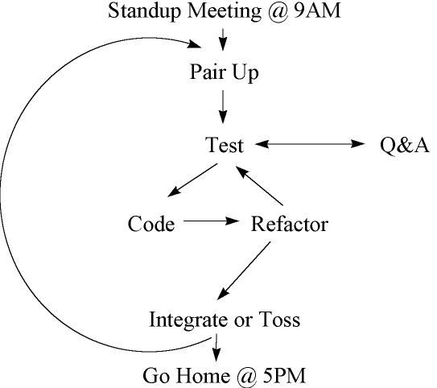
A Day In XP

Slide 122
9. Coding standard
Without coding standards, it is harder to refactor code, harder to switch pairs as often as you should, and harder to go fast.
The goal should be that no one on the team can recognize who wrote which piece of code.
Make sure your code communicates clearly.
Don't spend too much time. Create the simplest standard that could possibly work.

Slide 123
10. System metaphor (Imagine)
A sort of map that lets developers see where new pieces will fit.
The metaphor gives the team a consistent picture they can use to describe the way the existing system works, where new parts fit, and what form they should take.
It is important to remember that having everyone understand how the system fits together.

Slide 124
11. The planning game
The main idea behind this practice is to make a rough plan quickly and refine it as things become clearer.
The development team determines:
Estimates of how long it will take to develop a module
Cost implications of using various technology options
Team organization
The "risk" of each module
Order of module development within an iteration (doing risky items first can ease risk)

Slide 125
11. The planning game
The customer determines:
Scope
Release dates
Priority (which features get developed first, based on business value)
Planning happens often. This provides frequent opportunity for either the customer or the developers to adjust the plan as they learn new things.

Slide 126
12. Testing
Unit testing
Developers write the unit tests as they write code.
Unit tests tell developers whether the system "works" at any point in time.
Developers write unit tests for every method that could possibly break, before they write the code for those methods. Then they write just enough code to get the test to pass.
Unit tests give developers confidence that their code works. It leaves a trail for other developers to understand the original developer's intent.
Unit tests also give developers courage to refactor the code, because a test failure tells the developer immediately if something's broken.
Unit tests should be automated and give a clear pass/fail result.

Slide 127
Testing
Acceptance testing
The customer writes acceptance tests after they define module.
Acceptance tests tell the team whether the system does what users want it to do.
Customers are responsible for making sure each story has acceptance tests to validate it. The customer can write the tests himself or recruit other members of his organization to write them, or combine the two approaches.
Acceptance tests should ensure developers are not breaking any existing features as they implement new ones.
Customers will need some help from the development team to write acceptance tests.

Slide 128
Common XP Misconceptions
No written design documentation
  Truth: no formal standards for how much or what kind of docs are needed.
No design
  Truth: minimal explicit, up-front design; design is an explicit part of every activity through every day.
XP is easy
  Truth: although XP does try to work with the natural tendencies of developers, it requires great discipline and consistency.

Slide 129
More Misconceptions
XP is just legitimized hacking
  Truth: XP has extremely high quality standards throughout the process
  Unfortunate truth: XP is sometimes used as an excuse for sloppy development
XP is the one, true way to build software
  Truth: it seems to be a sweet spot for certain kinds of projects

